Slide 1
2022 Midterms, Looking Back and Beyond JANUARY 23, 2023
Tom Patterson

Slide 2
LOOking back on 2022 midterms

Slide 3
Why was a Red Wave expected in 2022?
Political science theories:
Surge and decline theory
Referendum theory (presidential approval – Biden at 43%)
An overriding issue – high inflation
Public mood – 70 percent of Americans thinking the nation was heading in the wrong direction
Historically, these indicators would have pointed toward a substantial Republican victory

Slide 4
The Midterm Tendency – House Elections

Slide 5
The Midterm Tendency – Senate Elections
The out party on average has picked u
4 Senate seats in the midterm, 5 more than
Republicans in 2022

Slide 6
Explaining Why the Red Wave Didn’t Happen
Abortion issue’s impact on congressional races
Trump’s impact on Senate races
The Big Sort’s impact on House races

Slide 7
Congressional races
The Abortion Issue

Slide 8
Enthusiasm Gap – Early 2022
Survey: Morning Consult-Politico polls

Slide 9
Enthusiasm Gap in Recent Midterms
Source: Gallup polls

Slide 10
Enthusiasm Gap - 2022
Survey: Morning Consult-Politico polls

Slide 11
2022 Exit Polls Democrats’ “Feeling about Roe v. Wade being overturned”
Source: 2022 Exit polls

Slide 12
The Abortion Issue – 2022 Exit Polls
Most Important Issue to Your Vote
Two-party vote by issue
Source: 2022 election exit polls

Slide 13
Senate Races
Luck, and The Trump Factor

Slide 14
The Luck Factor
Going into Election Day, Politico rated six Senate races as toss-ups.
Democrats won 5 (Arizona, Georgia, Nevada, New Hampshire, and Pennsylvania) out of the 6, losing only to incumbent Senator Ron Johnson by 1 percentage point in Wisconsin.
The statistical probability that Democrats would win 5 of 6 toss-up elections is 9%.
The last such Senate election was in 1980, when Republicans won 7 of 7 toss-ups, enabling them to take control of Senate for first time since early 1950s. The odds of winning 7 out of 7 is 1%.

Slide 15
The Trump Factor
Breaking with tradition for a former president, Donald Trump campaigned actively for the election of eight Republican Senate Republican candidates (Johnson, Wisconsin; Oz, Pennsylvania; Masters, Arizona; Walker, Georgia; Vance, Ohio; Budd, North Carolina; Laxalt, Nevada; Bolduc, New Hampshire).
Five of the eight lost, including the flipped Pennsylvania Senate seat, leading pundits to claim that Trump cost Republicans control the Senate.
But is there any evidence to support the claim? Was Trump a drag on these races and, if so, how big a drag?

Slide 16
Estimating the Trump Factor – Republican Senate margins in 2016 and 2022
Note: Trump states are the 8 states where Trump was deeply engaged in the 2022 Senate races. Of non-Trump states, California and Alaska excluded
from calculations because the 2016 and 2022 races are not comparable. In 2016, California’s two general election candidates were Democrats as a result of the state’s top-two primary system. In 2016, Alaska had a competitive 3-candidate race.

Slide 17
House races
The Big Sort

Slide 18
Referendum Theory of Midterm Elections
The Theory: After taking office, presidents typically make more enemies than friends because of their policies and national conditions, which leads to declining popularity that weakens appeal of president’s party in midterms.

Slide 19
Change in Presidential Approval Rating from First Year in Office to Second Year
Source: Gallup polls

Slide 20
Presidential approval rating and Out-Party Share of Midterm House Vote Nationally
Presidential
approval
rating
Note: Slope based on 1962-2018 midterms

Slide 21
Out-Party Share of National House Vote and Out-Party Gain in House Seats
Out-party
gain/loss of
House seats

Slide 22
Actual Nationwide House Vote in 2022
Percentage is nearly
exactly what referendum
theory predicted.
And yet, despite outpolling Democrats by
nearly 3 percentage points nationally, Republicans gained only 9 seats instead of the roughly 25 seats the model would predict

Slide 23
The Arithmetic Puzzle
What might explain the fact that Republican House candidates nationwide had a roughly 3 percentage points edge in the national vote but picked up only 9 House seats?

Slide 24
Gerrymandering Doesn’t Explain It – Republicans Controlled More of the Redistricting
In fact, if not for court decisions in New York
and two other states that went against
advantageous Democratic districting, Democrats
would have retained control of the House.
Source: FiveThirtyEight

Slide 25
Explaining the Republican Shortfall – “The Big Sort”
Over the past two decades, red states have gotten redder and blue states have gotten bluer.
But the red states have gotten redder to a more substantial degree than the blue states have gotten bluer.
As a result, red states “waste” more votes than blue states.

Slide 26
House Vote in 2022
3.6%
difference
NOTE: In constructing the chart, red states were AL, AK, AR, ID, IN, KS, KY, LA, NE, ND, MO, MS, OK, SC, SD, TN, TX, UT, WV, WY whereas blue states were CA, CT, DE, HI, IL, MA, MD, MN, NY, NJ, OR, RI, VT, WA. Some analysts would place CO and NM in the blue state category. If they had been included in the calculations, the Democratic percentage in the blue states would have been lower, widening the gap in “wasted votes” between red and blue states.

Slide 27
Looking ahead to 2024 Elections

Slide 28
2024 Senate and House races
“In the end, the arithmetic is decisive.”
Arthur Schlesinger, Jr., historian & presidential advisor

Slide 29
The Arithmetic: Senate Races
Of the 34 seats up in 2024 –
Democrats are defending 23 seats (nearly half of their Senate majority)
Republicans are defending 11 seats (less than a fourth of their current members)
To gain control of the Senate, Republicans need a net gain of 2 seats or only 1 seat if they win the presidency in 2024.

Slide 30
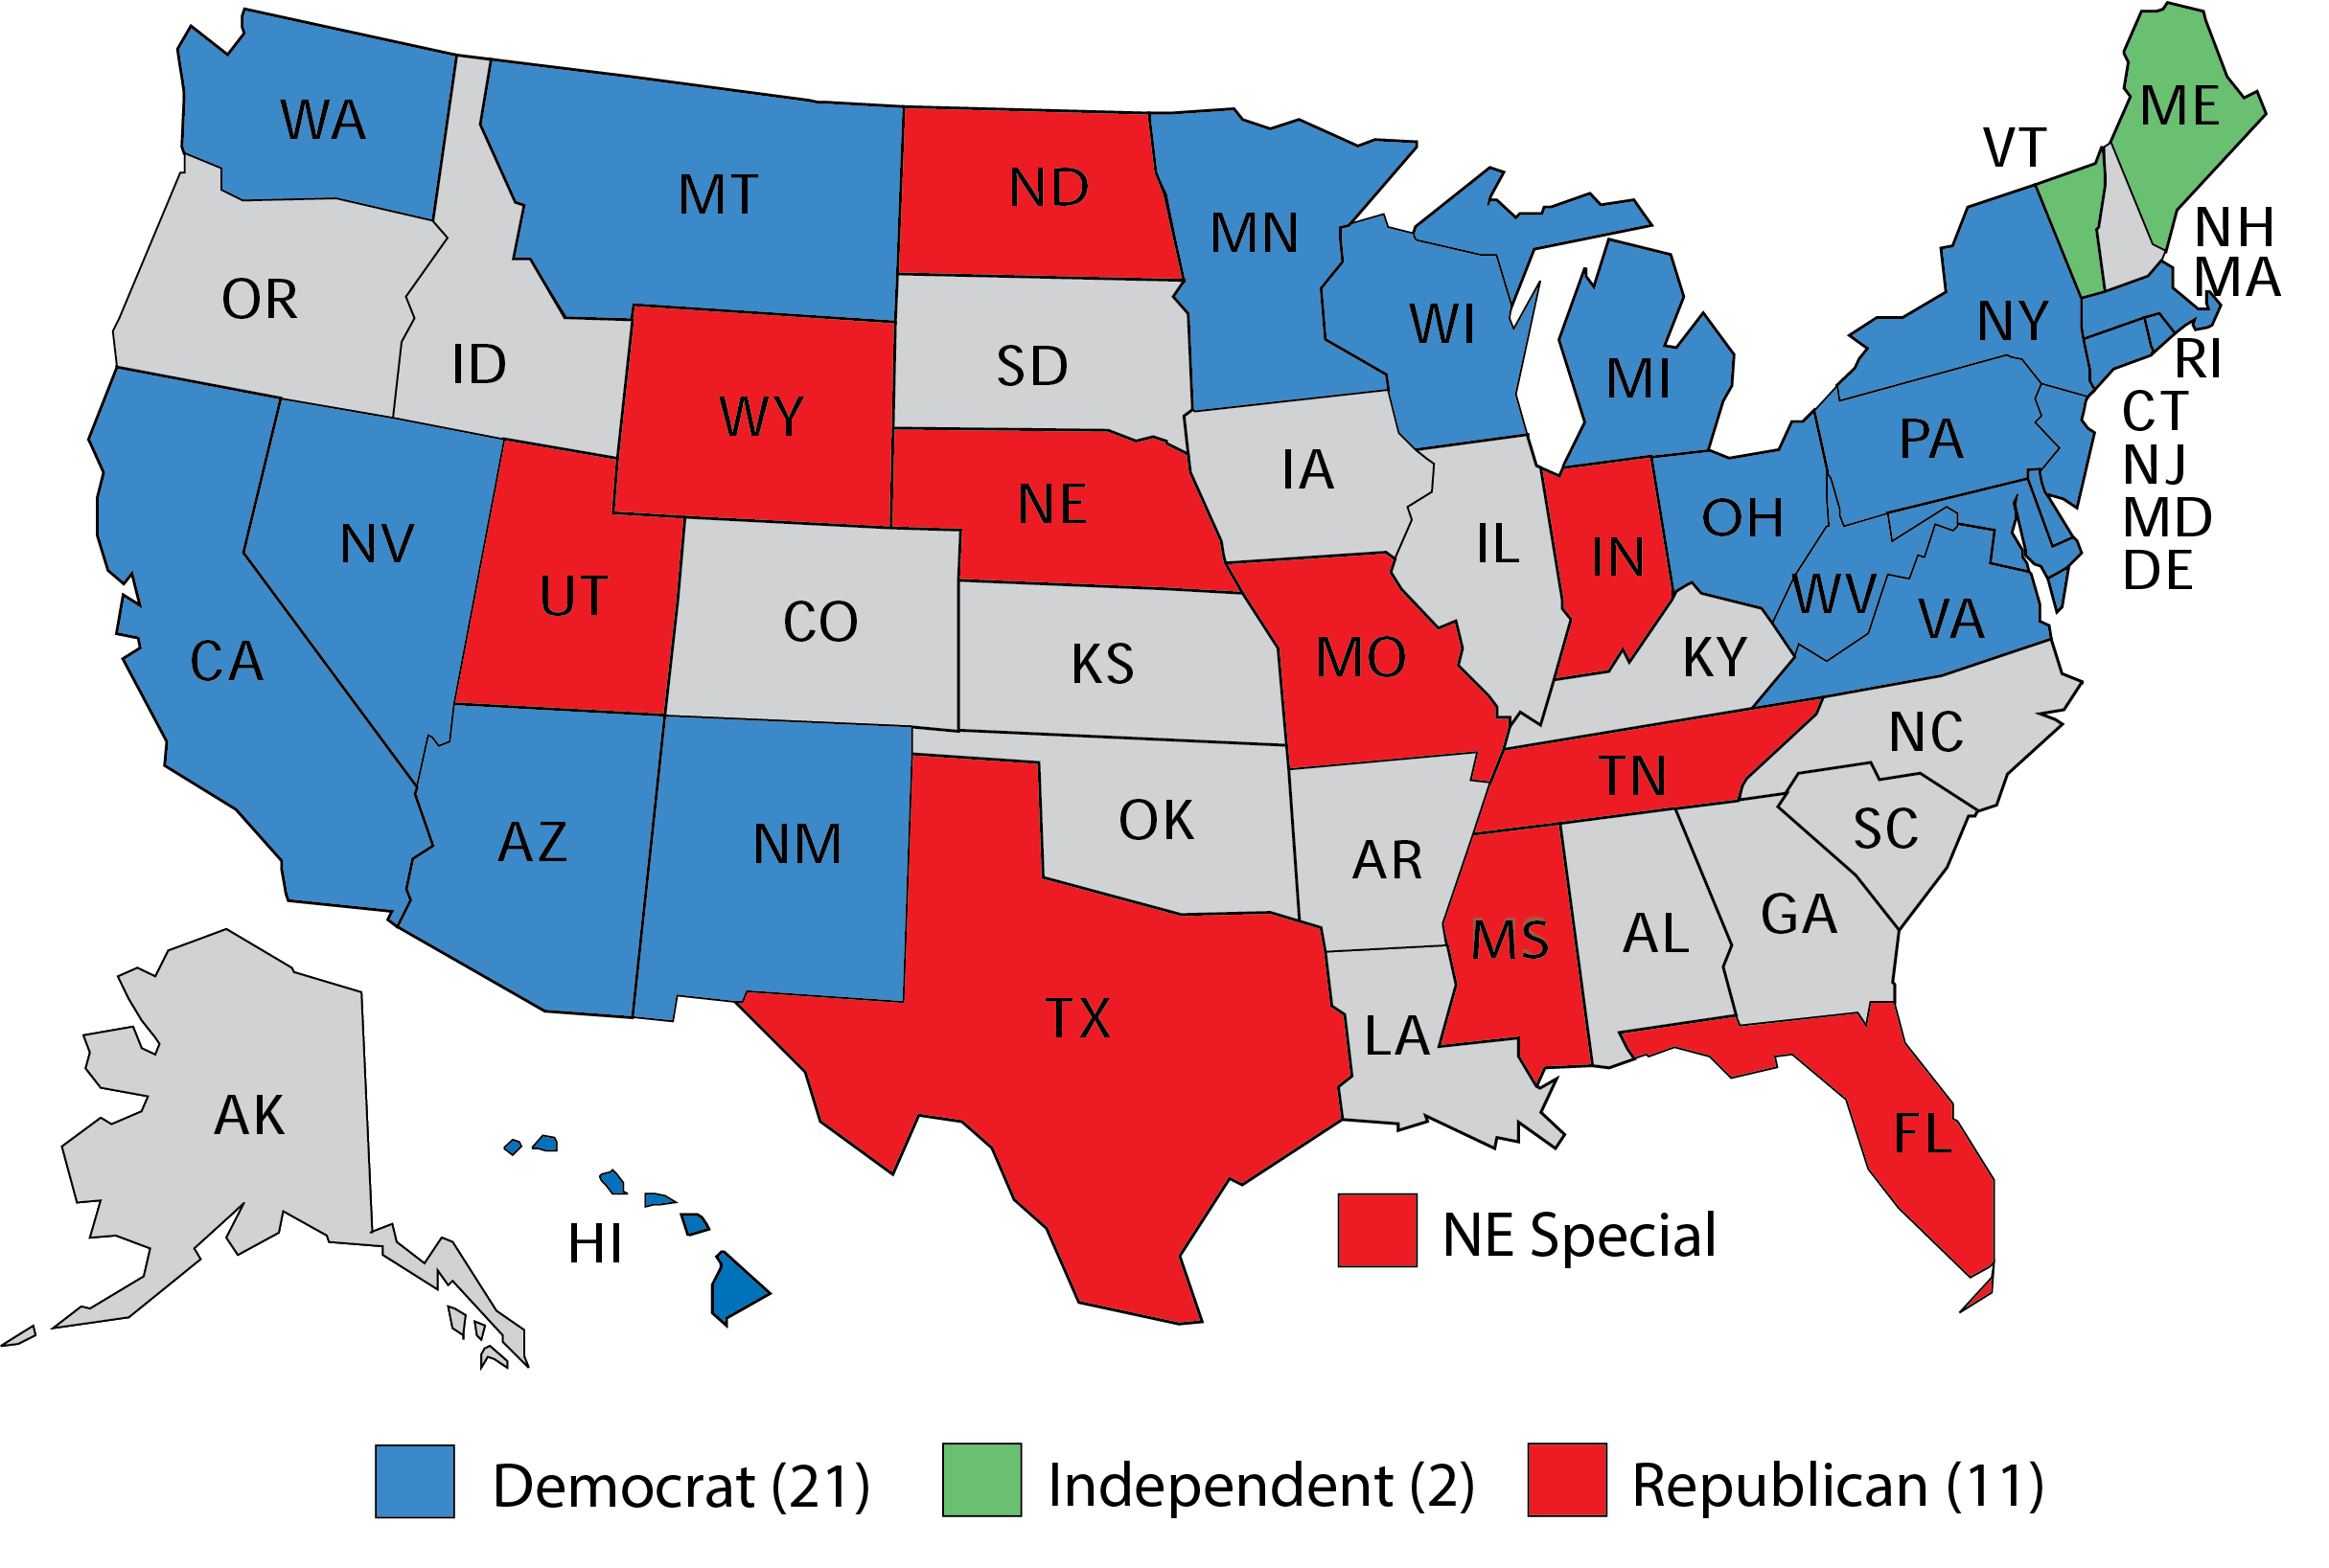
2024 Senate Races – Democrats are defending 23 seats, Republicans 11 seats

Slide 31
The 8 Senate Seats Most Likely to Flip in 2024
Source: Vulnerable seats based on combined assessments of Cook Political Report, 538, and CNN.

Slide 32
The Most Vulnerable of the 8 Democratic Senate Seats
West Virginia – Manchin is 10 points behind Jim Justice in latest poll

Slide 33
The Reality of Joe Manchin’s Political World West Virginia Voters (2020 Election)
Manchin won his
2018 Senate race
by 3 percentage points.

Slide 34
The Other 7 Vulnerable Democratic Senate Seats
Montana – if Tester retires, Democrats will likely lose; Tester could also lose
Arizona – if Sinema runs as Independent, Democratic vote will split and Republicans will pick up the seat
Ohio – Brown is running but Ohio is increasingly Republican
Nevada – Rosen is running but it’s a toss-up state
Wisconsin – Baldwin is running but it’s a toss-up state
Michigan – open seat in a toss-up state
Pennsylvania – Casey is running and looks the safest of the 8 but Pennsylvania is a toss-up state.

Slide 35
Competitive House Races in 2024, according to Cook Political Report
IN SUM:
Democrats are defending more competitive House seats – 23-19 – than
Republicans
Toss-up district, Republic
incumbent
Toss-up district, Democratic incumbent
Leans Republican district, Republic
incumbent
Leans Democratic
district, Democrat
incumbent

Slide 36
The Arithmetic: Democrats’ Chances of Retaking Control of House
Democrats would need to flip 5 seats
If Democrats were to retain all 23 of their toss-up/leaning districts, they would need to win 5 of the 19 Republican toss-up/leaning districts
For each Democratic toss-up/leaning district lost to Republicans, Democrats would need to pick an additional Republican toss-up/leaning districts
At the moment, odds are that Republicans will retain control of the House

Slide 37
Generic House Ballot, 2024
Source: Hart Associates NBC News Poll, January 24, 2023

Slide 38
2024 presidential race

Slide 39
Can Trump Win the Nomination? Republican voters’ preferences at the moment
Source: Morning Consult poll, Feb 17-19, 2023

Slide 40
The Presidential Race – as of this week
Note: Percentages are average of most recent Harvard-Harris, Quinnipiac, and Reuters/ISPOS polls.

Slide 41
But this is early 2023, not November of 2024.
What between now and then could tip the presidential election toward one party or the other?
From political science research, we know that the best non-campaign predictor of whether the in-party will retain the presidency is usually the state of the economy in the election year.

Slide 42
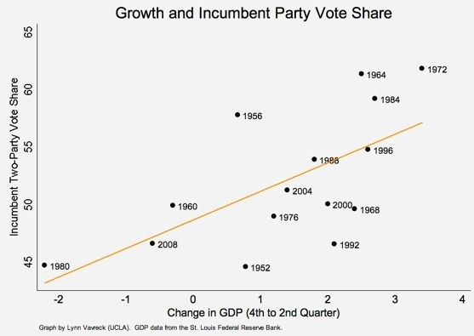
The Economy and Presidential Election Outcome GDP and incumbent-party share of presidential vote
Notes:
The data suggest that for every 1 percent growth in GDP from the fourth to the second quarter of an election year, an incumbent party can expect to pick up an additional 2.5 percentage points on Election Day. Two-and-a-half points in vote share may sound small, but consider that of the 16 elections in these graphs, five elections (1960, 1968, 1976, 2000, and 2004) were decided by this small (or smaller) a margin of victory.

Slide 43
Two Elections to Consider GDP and incumbent-party share of presidential vote
Reagan’s
reelection
bid
Carter’s
Reelection
bid
Notes:
The data suggest that for every 1 percent growth in GDP from the fourth to the second quarter of an election year, an incumbent party can expect to pick up an additional 2.5 percentage points on Election Day. Two-and-a-half points in vote share may sound small, but consider that of the 16 elections in these graphs, five elections (1960, 1968, 1976, 2000, and 2004) were decided by this small (or smaller) a margin of victory.

Slide 44
Will Biden be like Carter (1980 election)?

Slide 45
Or Will Biden be like Reagan (1984 election)?

Slide 46
Timing Is (Nearly) Everything in Politics Reagan, if 1982 had been a presidential election year
Reagan’s
reelection
bid
Carter’s
Reelection
bid
1982
Notes:
The data suggest that for every 1 percent growth in GDP from the fourth to the second quarter of an election year, an incumbent party can expect to pick up an additional 2.5 percentage points on Election Day. Two-and-a-half points in vote share may sound small, but consider that of the 16 elections in these graphs, five elections (1960, 1968, 1976, 2000, and 2004) were decided by this small (or smaller) a margin of victory.

Slide 47
Final Thoughts on 2024
Democrats’ best scenario:
If inflation substantially declines and economy heats up –
Biden should win easily, and Democrats should win the bulk of competitive House districts, enabling them to capture the House. Even so, the Senate might be out of reach.
Republicans’ best scenario: If inflation stays high and the economy cools down –
GOP presidential candidate (Trump could be an exception if the nominee) wins the election, and Republicans easily retain control of House and easily take control of Senate.

Slide 48
Thank You
Questions, Observations, Objections?

